Slide 1
Unit-II Interactive design basics

Slide 2
What Is Design
achieving goals within constraints
Goals - What is the purpose of the design, Who is it for?, Why do they want it?
Constraints -What materials must we use?

Slide 3

Definition of Design
The term ‘design’ refers to:
It is the creative process of specifying something new.
And the representations that are produced during the process.

Slide 4
Golden rule of design
Understand your materials

Slide 5
For Human–Computer Interaction
Understand your materials
Understand Computers
limitations, capacities, tools, platforms
Understand People
psychological, social aspects
human error
And their interaction …

Slide 6
The process of design
Scenarios Task analysis
what is wanted
Guidelines
Principles
Standards
analysis
Interviews
Ethnography
what is there
vs.
what is wanted
Precise Specification
design
Dialogue Notations
implement
and deploy
Evaluation
Heuristics
prototype
Architectures
Documentation
Help

Slide 7
Ethnography
Ethnography (from Greek ethnos " folk, people, nation" and grapho "I write") is the systematic study of people and cultures.
It is the scientific description of peoples and cultures with their customs, habits, and mutual differences.

Slide 8
Task Analysis
Helps us understand what users do
Forces us to synthesize the data into a useful format
Lays the foundation for screen design
Identifies weak points and sources of error in the task flow

Slide 9
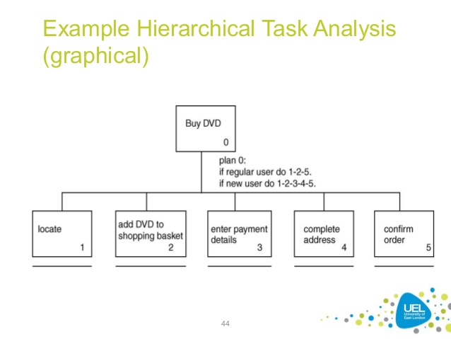
Example for Task Analysis

Slide 10
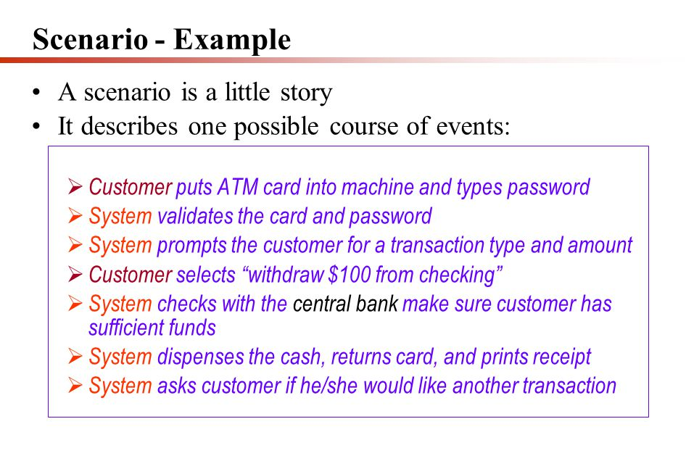
Scenario

Slide 11
Steps …
Requirements
what is there and what is wanted …
Analysis
ordering and understanding
Design
what to do and how to decide
Iteration and prototyping
getting it right … and finding what is really needed!
Implementation and deployment
making it and getting it out there

Slide 12
know your user
Who are they?
Probably not like you!
Talk to them
Watch them
Use your imagination

Slide 13
Design techniques
Sketching
Scenarios
Storyboards

Slide 14
Sketching Designs
Draw your ideas
By hand, not by drawing program
Paper or whiteboard
Generate many ideas
Design in a group

Slide 15
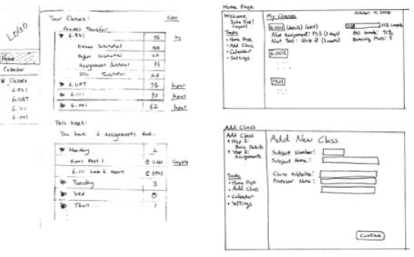
Examples of Design Sketches

Slide 16
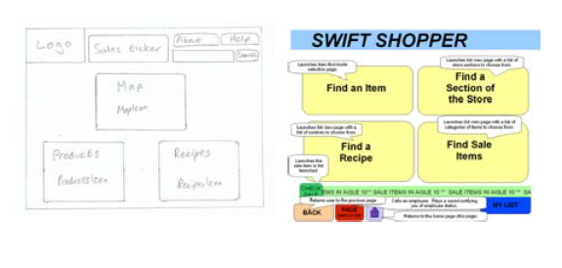
Examples of Design Sketches

Slide 17
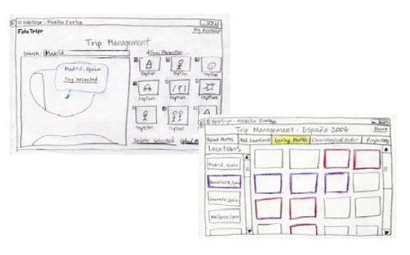
Examples of Design Sketches

Slide 18
Scenarios
Scenarios is a story about a user using the system
Concrete and realistic
Involves a user with a goal
Follows how the user achieves the goal

Slide 19
Scenarios …
What will users want to do?
Step-by-step walkthrough
What can they see (sketches, screen shots)
What do they do (keyboard, mouse etc.)
What are they thinking?
Use and reuse throughout design

Slide 20
Scenarios …

Slide 21
Navigation Design
Start the structure of the application
Main screens or modes within a system and how they interconnect.
Think about actual use:
who is going to use the application?
how do they think about it?
what will they do with it?
local structure
looking from one screen or page out
global structure
structure of site, movement between screens.

Slide 22
Storyboards
Sequence of sketches illustrating a scenario
First prototype of a design
Shows how the design can actually be used to satisfy a goal

Slide 23
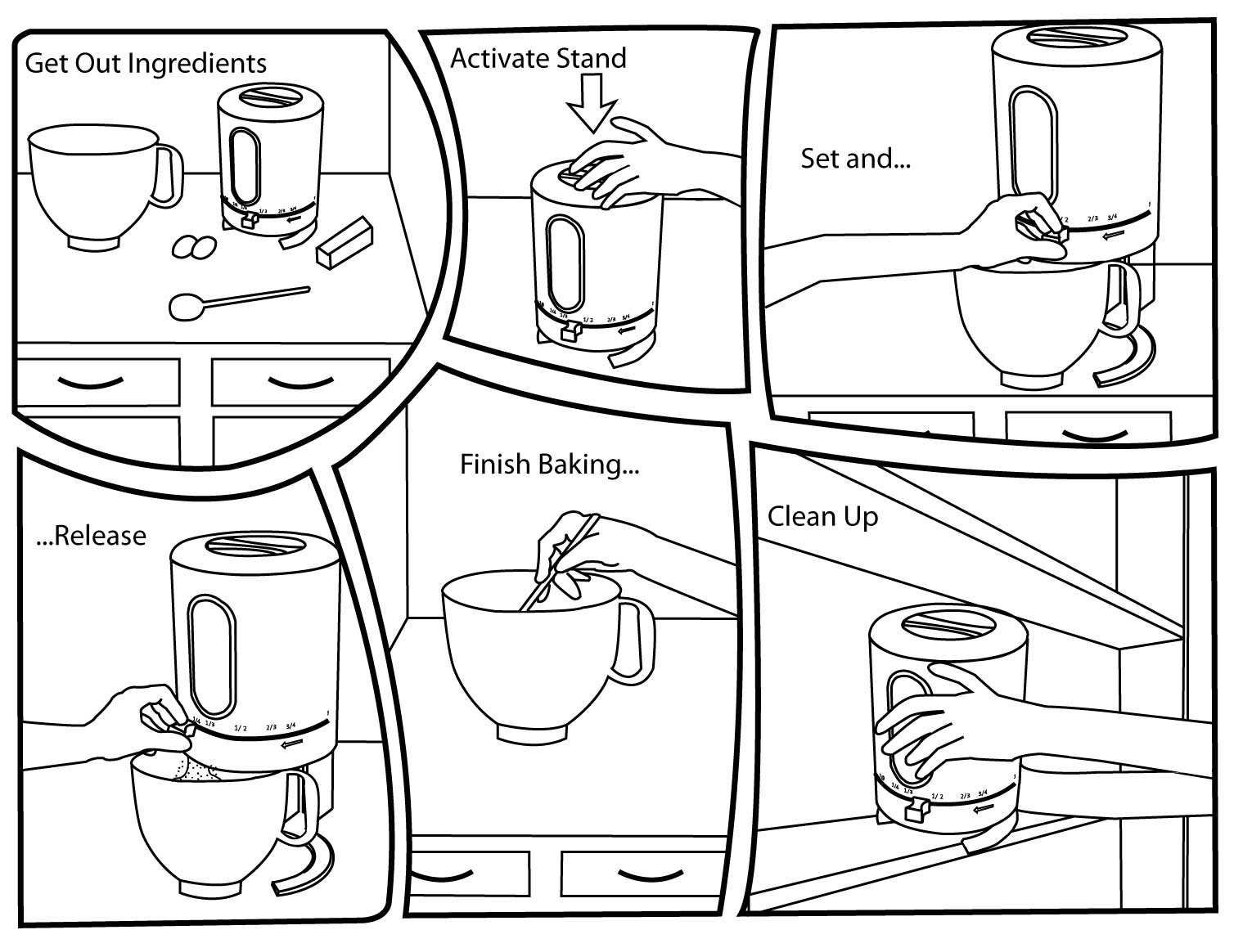
Example-Story Board

Slide 24
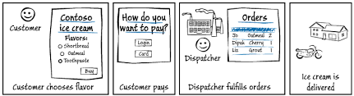
Example-Story Board

Slide 25
screen design and layout

Slide 26
Basic principles
Ask
What is the user doing?
Think
What information, comparisons, order
Design
Form follows function

Slide 27
Available tools
Grouping of items
Order of items
Decoration - fonts, boxes etc.
Alignment of items
white space between items

Slide 28
Grouping and structure
logically together ⇒ physically together
Billing details:
Name
Address: …
Credit card no
Delivery details:
Name
Address: …
Delivery time
Order details:
item quantity cost/item cost
size 10 screws (boxes) 7 3.71 25.97
…… … … …

Slide 29
Order of groups and items
think! - what is natural order
should match screen order!
use boxes, space etc.
set up tabbing right!
instructions
beware the cake recipie syndrome! … mix milk and flour, add the fruit after beating them

Slide 30
Decoration
use boxes to group logical items
use fonts for emphasis, headings
but not too many!!
ABCDEFGHIJKLM
NOPQRSTUVWXYZ

Slide 31
Alignment - text
you read from left to right (English and European)
⇒ align left hand side
boring but
readable!
Willy Wonka and the Chocolate Factory
Winston Churchill - A Biography
Wizard of Oz
Xena - Warrior Princess
Willy Wonka and the Chocolate Factory
Winston Churchill - A Biography
Wizard of Oz
Xena - Warrior Princess
fine for special effects but hard to scan

Slide 32
Alignment - names
Usually scanning for surnames ⇒ make it easy!


R, Jeberson
V, Radhakrishna
Anitha, Aravindth
N, Ramesh
L , Saravanan
Jeberson R
Radhakrishna V
Anitha Aravindth
Ramesh N
Saravanan L

Jeberson R
Radhakrishna V
Anitha Aravindth
Ramesh N
Saravanan L

Slide 33
Alignment - numbers
think purpose!
which is biggest?
532.56 179.3 256.317 15 73.948 1035 3.142 497.6256

Slide 34
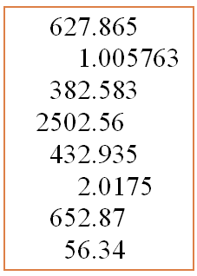
Alignment - numbers
visually:
long number = big number
align decimal points
or right align integers

Slide 35
Multiple columns
scanning across gaps hard: (often hard to avoid with large data base fields)
sherbert 75 toffee 120 chocolate 35 fruit gums 27 coconut dreams 85

Slide 36
multiple columns - 2
use leaders
sherbert 75 toffee 120 chocolate 35 fruit gums 27 coconut dreams 85

Slide 37
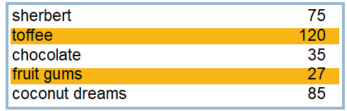
Multiple columns - 3
or greying (vertical too)

Slide 38
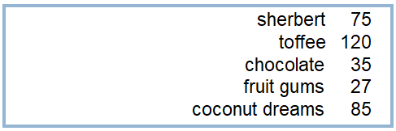
Multiple columns - 4
or even (with care!) ‘bad’ alignment

Slide 39
white space - the counter
WHAT YOU SEE

Slide 40
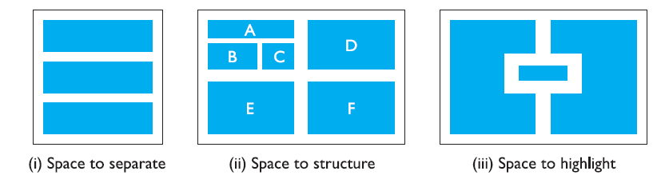
white space - the counter

Slide 41
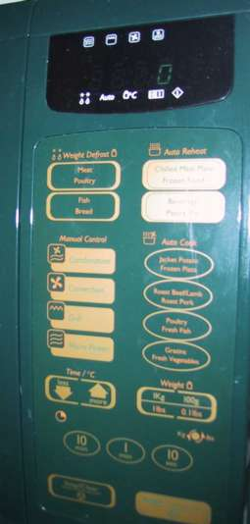
Physical controls
grouping of items
defrost settings
type of food
time to cook
defrost settings
type of food
time to cook

Slide 42
Physical controls
grouping of items
order of items
1) type of heating
1
2) temperature
3) time to cook
2
4) start
3
4

Slide 43
Physical controls
grouping of items
order of items
decoration
different colours for different functions
lines around related buttons
different colours for different functions
lines around related buttons (temp up/down)

Slide 44
Physical controls
grouping of items
order of items
decoration
alignment
centered text in buttons ? easy to scan ?
centred text in buttons
? easy to scan ?

Slide 45
Physical controls
grouping of items
order of items
decoration
alignment
white space
gaps to aid grouping
gaps to aid grouping

